Slide 1

Inconvenient Camera App
Rohan Shyam
Afeef Rahman​

Slide 2

Why this App
Taking photos has become too easy. No legal accountability, no emotional weight—just snap and go. In a world where everything is instant, we felt people weren’t earning their photos and they should go through some inconvenience.

Slide 3

About Our Product
An Android camera app that places a deliberately inconvenient barrier between the user and the camera. Before taking a photo, users are forced to go through an unnecessarily tedious verification process involving Terms and Conditions—every single time. The app is designed to frustrate, delay, and question why you even wanted to take a photo in the first place.

Slide 4

Primary goals
The app is designed to frustrate, delay, and question why you even wanted to take a photo in the first place.

Slide 5
Some Screenshots

Slide 6
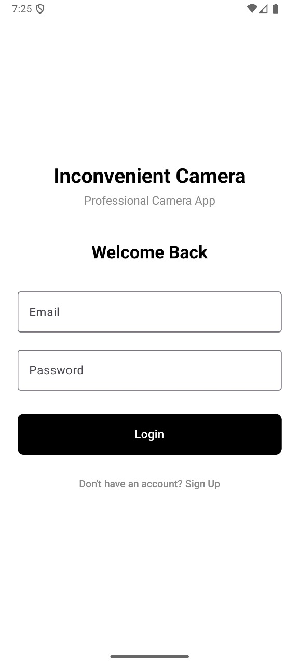


Slide 7
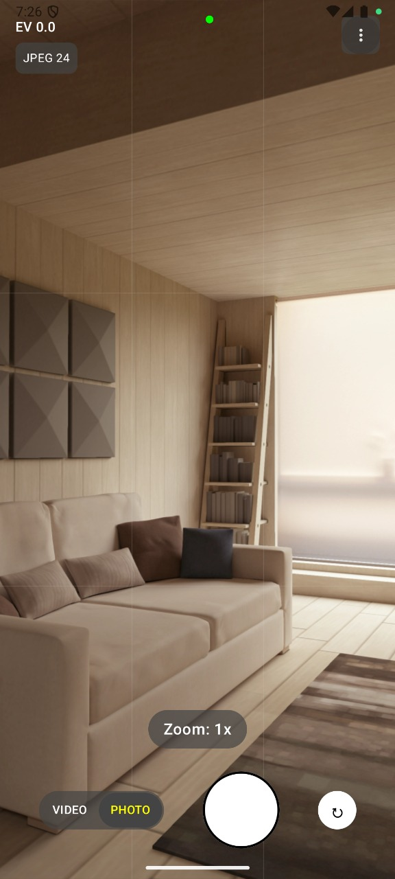

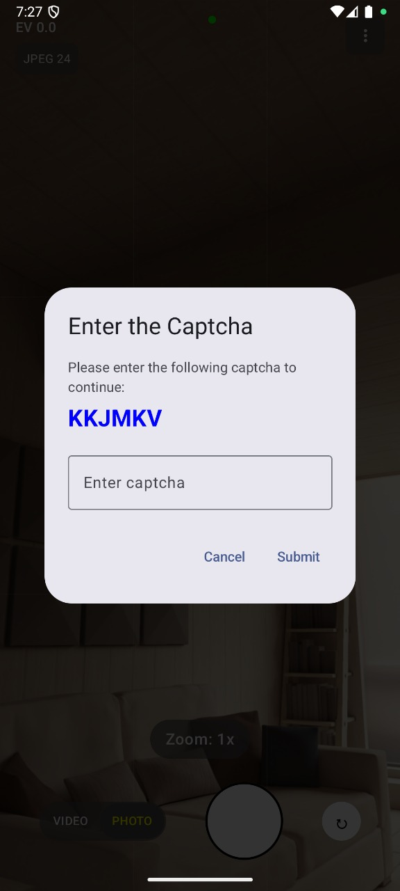

Slide 8

Isn’t Just WOWWWWWWW

Slide 9
"Finally, a camera app that makes you question all your life choices”
“
”
Richard Branson

Slide 10
LINKS

Slide 11



Meet our team
Takuma Hayashi
Mirjam Nilsson
Flora Berggren
President
Chief Executive Officer
Chief Operations Officer

Slide 12
Timeline
Sep 20XX
Synergize scalable e-commerce
Jan 20XX
Coordinate e-business applications
May 20XX
Deploy strategy networks with compelling e-business needs
Nov 20XX
Disseminate standardized metrics
Mar 20XX
Foster holistically superior methodologies

Slide 13
Areas of focus
B2B market scenarios​
Develop winning strategies to keep ahead of the competition
Capitalize on low-hanging fruit to identify a ballpark value
Visualize customer directed convergence
Cloud-based opportunities
Iterative approaches to corporate strategy
Establish a management framework from the inside

Slide 14
How we get there​
ROI​
Niche markets
Supply chains​
Envision multimedia-based expertise and cross-media growth strategies​ Visualize quality intellectual capital​ Engage worldwide methodologies with web-enabled technologies​ ​
Pursue scalable customer service through sustainable strategies​ Engage top-line web services with cutting-edge deliverables​
Cultivate one-to-one customer service with robust ideas​ Maximize timely deliverables for real-time schemas

Slide 15

Summary
At Contoso, we believe in giving 110%. By using our next-generation data architecture, we help organizations virtually manage agile workflows. We thrive because of our market knowledge and great team behind our product. As our CEO says, “Efficiencies will come from proactively transforming how we do business.”

Slide 16

Thank you
Mirjam Nilsson
mirjam@contoso.com
www.contoso.com

